Slide 1
Input and Output Streams
Chapter 19

Slide 2
Contents
Java I/O classes and Interfaces
File Handling
Stream Classes: Byte Stream and Character Stream

Slide 3
Introduction
Working with java.io.* package
Operates with external data
Data is retrieved from input Source
Results are send to output Destination
Sources and Destination devices:
Network connection, memory buffer, or disk file
These devices handles data as: Stream

Slide 4
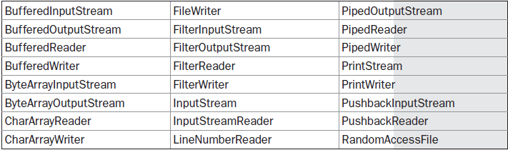
1. Java I/O Classes and Interfaces
Classes in java.io package

Slide 5
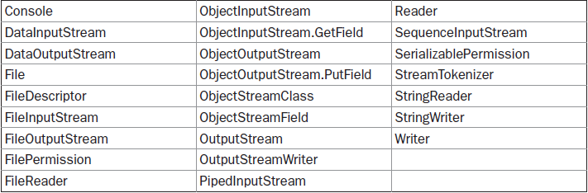
1. Java I/O Classes and Interfaces

Slide 6
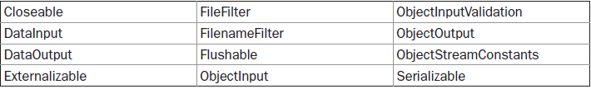
1. Java I/O Classes and Interfaces
Interfaces in java.io package

Slide 7
2. Handling Files
File class does not operate with input and output streams
i.e.., File class does not specify how information is retrieved from or stored in files
File object only maintains:
File permissions, time, date, and directory path

Slide 8
Constructors in File
File(String directoryPath)
File(String directoryPath, String filename)
File(File dirObj, String filename)
File(URI uriObj)
Some other methods:
getName( ) → Returns the name of the file
getParent( ) → Returns the name of directory
exists( ) →returns true if the file exists, else false

Slide 9
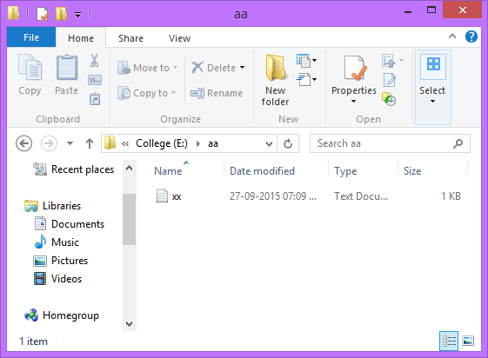

Slide 10
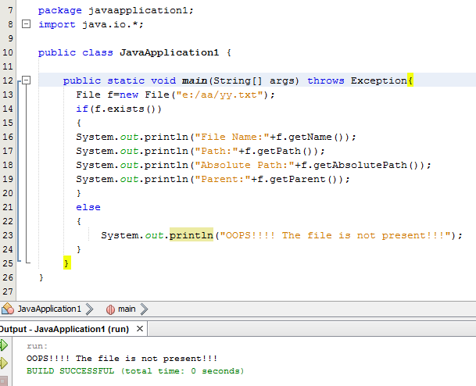

Slide 11
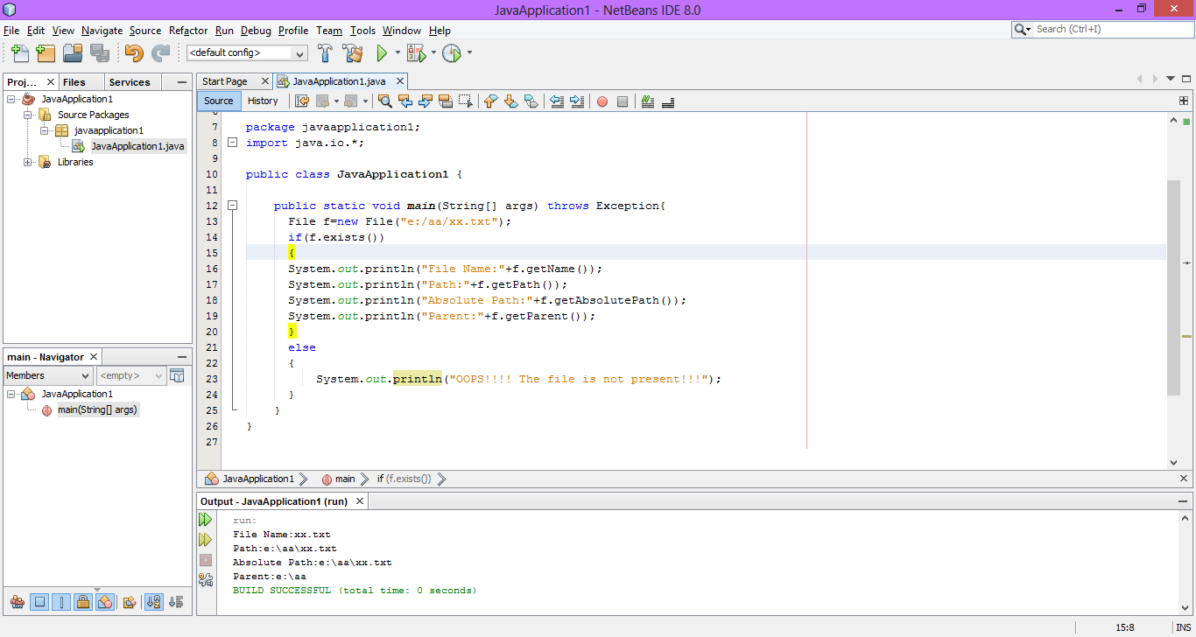

Slide 12
Some other utility methods…
boolean renameTo(File newName);
Invoking file is renamed and returns true if success
boolean delete( );
Deletes the invoking file
long lastModified( );
Returns the time in milliseconds representing last modified time
int length( );
Returns the length in bytes.

Slide 13
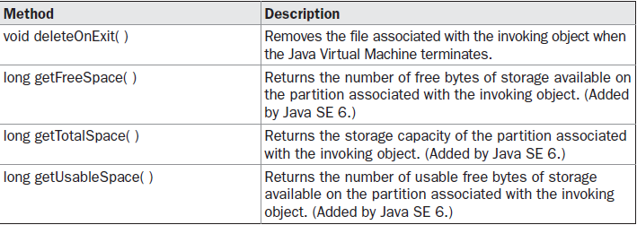
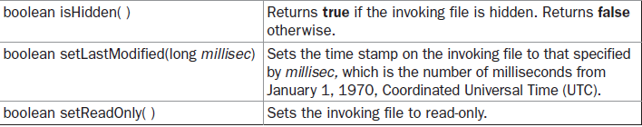
Some other methods…

Slide 14
Directories
A directory is a File that contains a list of other files and directories
Methods:
boolean isDirectory( ) → checks if the invoking object is a directory
String[ ] list( ) → returns the names of all files and directories inside the invoking directory

Slide 15
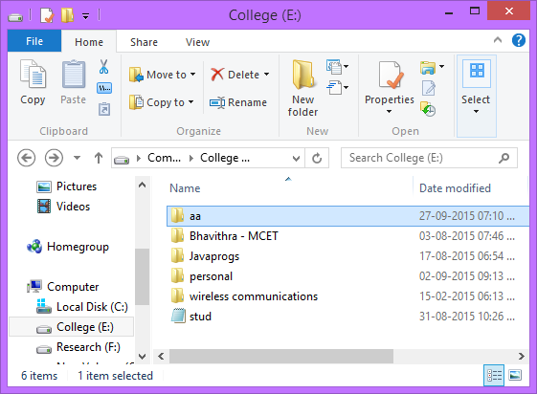

Slide 16
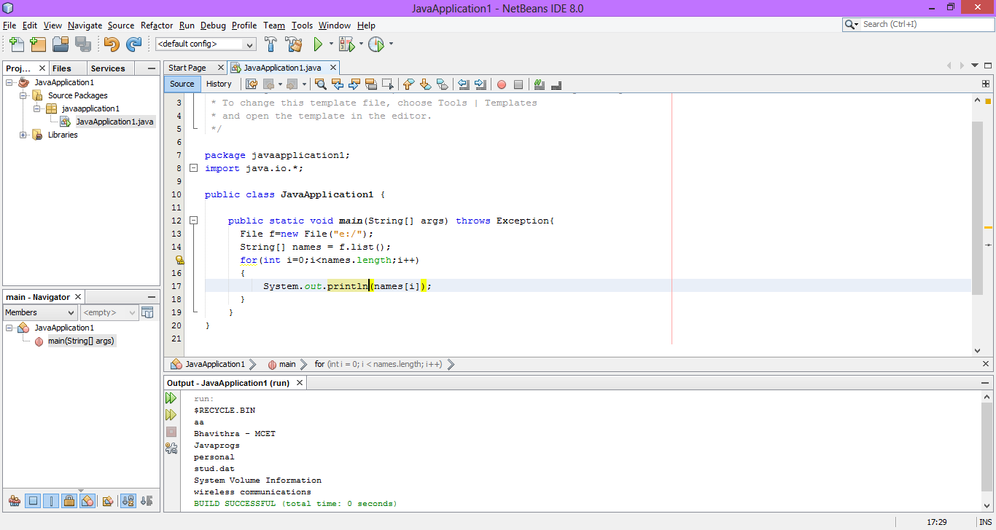

Slide 17
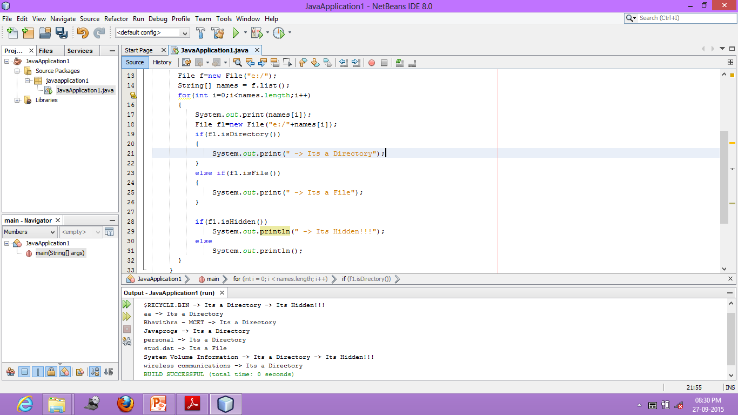

Slide 18
Using Filename Filter
Used to filter the list of files returned by list() function
Hence returning only those files that match a certain filename pattern
String[ ] list(FilenameFilter FFObj)
FilenameFilter → A file interface
Which calls:
boolean accept(File directory, String filename)

Slide 19
listFiles() method
This method returns a list of “File” instances inside a directory
Constructors:
File[ ] listFiles( )
File[ ] listFiles(FilenameFilter FFObj)
File[ ] listFiles(FileFilter FObj)

Slide 20
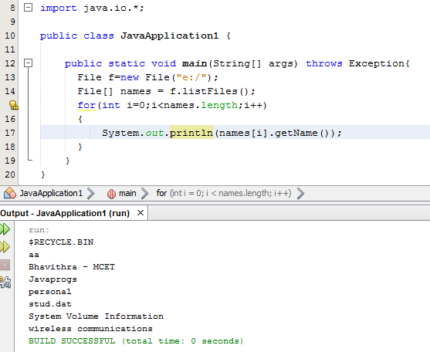

Slide 21
Creating Directories
Methods used to create directories:
mkdir( ) → creates a directory, returning true on success and false on failure
False is returned if the path is not properly specified; or path already exists
mkdirs( ) → creates a directory for which no path exists
Ie.., It creates both a directory and all the parents of the directory

Slide 22
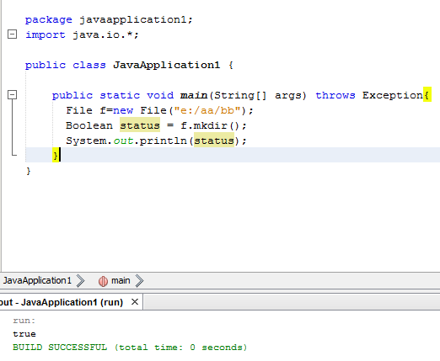

Slide 23
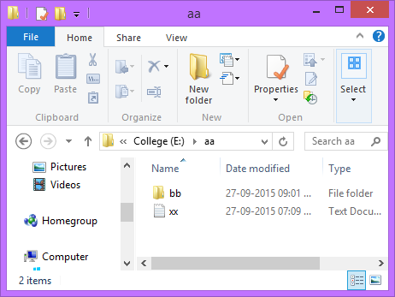

Slide 24
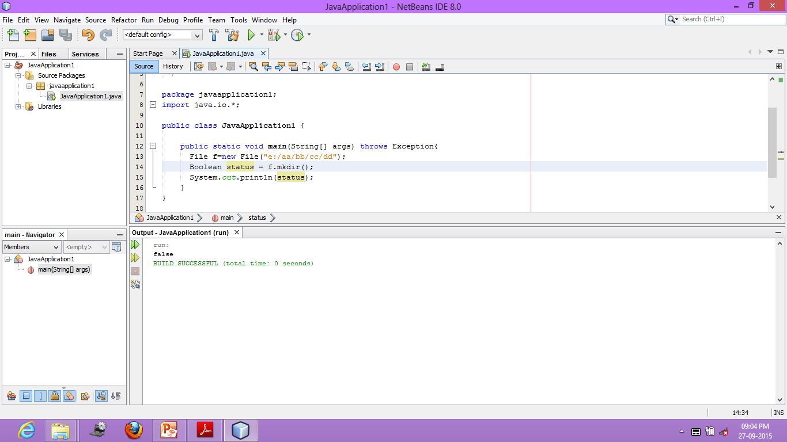

Slide 25
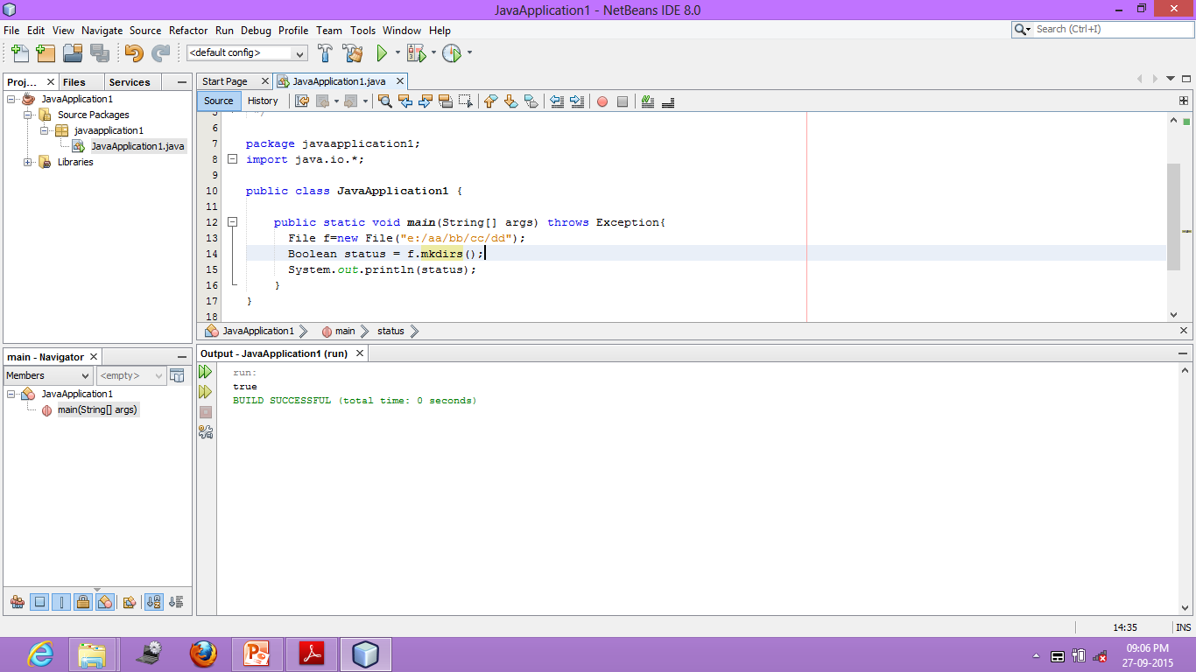

Slide 26
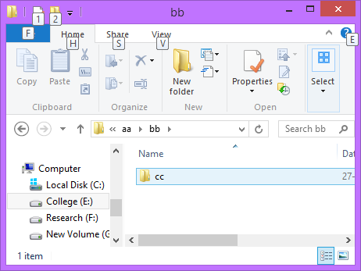
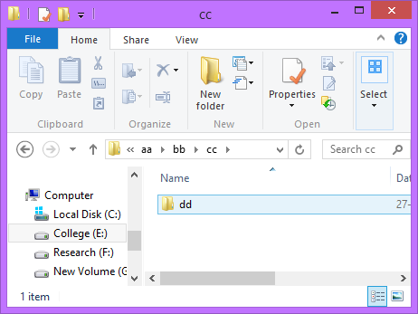

Slide 27
The Closeable and Flushable Interfaces
Released in JDK 5
They offer a uniform way of specifying that a stream can be closed or flushed
void close( )
This method closes the invoking stream, releasing any resources that it may hold
void flush( )
Force buffered output to be written to the stream to which the object is attached

